Slide 1
Mesa Water District Customer Survey
Presented by
Timothy McLarney Ph.D.
True North Research, Inc.

Slide 2
Methodology of Study
Conducted July 25 to August 22, 2022
800 residential customers in the District’s service area
Oversample for single-family homeowners, balanced evenly across five Divisions
Mixed-Method approach
  Recruited via email, text, and phone
  Data collection via phone and online
  16-minute average interview length
  English & Spanish
Overall margin of error is ± 3.4%

Slide 3
Most Important Issue Facing Community
Notes:
Q1 To begin, what do you feel is the most important issue facing your community today?

Slide 4
Water Supply Reliability by Study Year
Notes:
Q2 A reliable water supply is one that can be depended upon to consistently provide enough water to meet a region’s needs.
Overall, how reliable do you think your household’s water supply is going to be over the next five years? Do you think it will be very reliable, somewhat reliable, somewhat unreliable, or very unreliable?

Slide 5
Knowledge of Water Origin by Study Year
Notes:
Q3 Thinking of the water your household receives, which of the following statements do you think is accurate: _____ OR _____? Rotate Statements

Slide 6
Awareness of Mesa Water by Study Year
Notes:
Q4 Do you happen to know which agency is responsible for providing water services to your home?
Q5 What is the name of the agency?
Q6 Prior to taking this survey, had you heard of the Mesa Water District?

Slide 7
Opinion of Mesa Water District by Study Year
Notes:
Q7 To clarify, the Mesa Water District is the independent public agency responsible for providing water services to your household.
In general, do you have a favorable or unfavorable opinion of the Mesa Water District – or do you not have an opinion either way? If favorable or unfavorable, ask: Would that be very (favorable/unfavorable) or somewhat (favorable/unfavorable)?

Slide 8
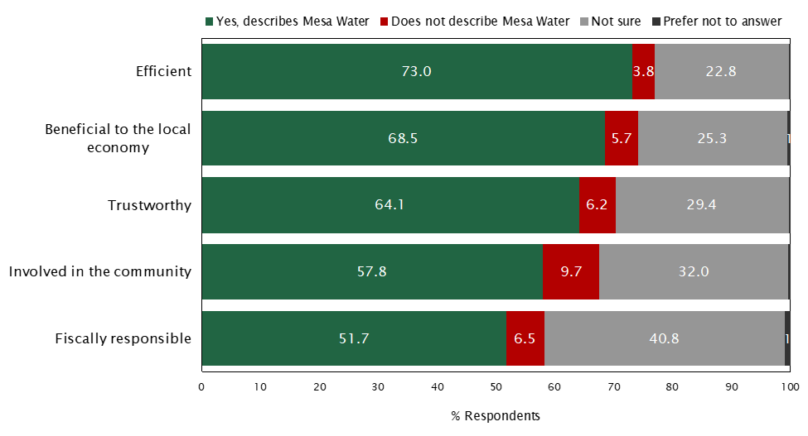
Descriptors for Mesa Water
Notes:
Question 9 Next, I'm going to read a series of words or phrases. For each I read, I'd like you to tell me whether - in your opinion - it accurately describes the Mesa Water District. 'Yes' means you think the phrase does accurately describe the Mesa Water District. No means it does not.
Notes: Statistically significant, positive movement on 4/5 statements

Slide 9
Overall Satisfaction With Service Provision by Study Year
Notes:
Q10 Generally speaking, are you satisfied or dissatisfied with the job the Mesa Water District is doing to provide water services to your household?

Slide 10
Satisfaction With Services Tier 1
Notes:
Q11 Next, I’m going to read a list of specific services provided by the Mesa Water District. For each of the services I read, please tell me whether you are satisfied or dissatisfied with the District’s efforts to provide the service. Are you satisfied or dissatisfied with the District’s efforts to: _____, or do you not have an opinion? Get answer. If ‘satisfied’ or ‘dissatisfied’, then ask: Would that be very (satisfied/dissatisfied) or somewhat (satisfied/dissatisfied)?

Slide 11
Satisfaction With Services Tier 2
Notes:
Q11 Next, I’m going to read a list of specific services provided by the Mesa Water District. For each of the services I read, please tell me whether you are satisfied or dissatisfied with the District’s efforts to provide the service. Are you satisfied or dissatisfied with the District’s efforts to: _____, or do you not have an opinion? Get answer. If ‘satisfied’ or ‘dissatisfied’, then ask: Would that be very (satisfied/dissatisfied) or somewhat (satisfied/dissatisfied)?

Slide 12
Home Water Source by Study Year
Notes:
Q12 At your home, do you primarily drink water straight from the faucet, filtered water from the faucet, or bottled water?

Slide 13
Customer Service Representative
Notes:
Q17. When contacting the Water District, where you satisfied or dissatisfied with ________ or do you not have an opinion?

Slide 14
Satisfaction With Communication Efforts by Study Year
Notes:
Q18 In general, are you satisfied or dissatisfied with the District’s efforts to communicate with customers through direct mail, newsletters, social media, and other means?

Slide 15
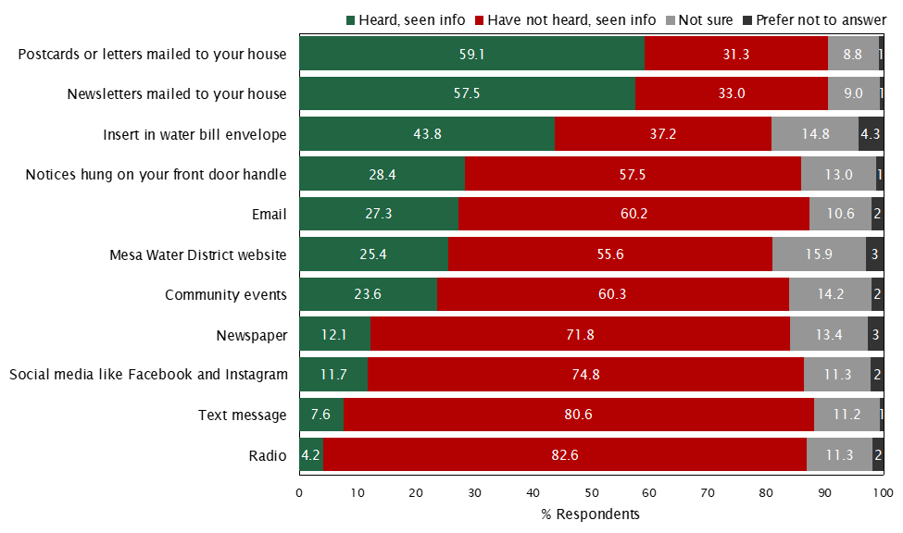
Recall of Mesa Water Information by Channel
Notes:
Q19 In the past year, have you seen or heard any news, information, or advertising from Mesa Water _________?

Slide 16
Key Findings
High level of customer satisfaction
90% of customers are satisfied with their water service
Satisfaction with specific aspects of service was very high, especially providing reliable service, providing convenient hours of operation, keeping water system in good condition, providing sufficient water pressure, and providing good customer service
Approximately 9-in-10 satisfied with ability to reach a customer service representative and their courtesy, knowledge and expertise
Notes:
Excellent report card!

Slide 17
Key Findings
High Awareness of District & Favorable Opinions
90% of customers were aware of Mesa Water prior to taking the survey
Percentage of customers who aren’t familiar enough with Mesa Water to form an opinion of the District has shrunk from 36% to 26% in four years
Among those with an opinion, favorable opinions of Mesa Water outnumber unfavorable opinions 17-to-1
Over the past two years, significant increases in percentage who view Mesa Water as efficient, beneficial to community, involved in the community, and fiscally responsible
Knowledge that all water is sourced locally increased 17% in past year, and these customers are more likely to hold favorable opinions of Mesa Water
Notes:
Excellent report card!

Slide 18
Key Findings
Opportunity Areas
Stay the course
Continue to improve customer understanding of water origins, especially as CA heads back into prolonged drought conditions
Expand rebate programs for water-efficient appliances
Offer good value for the cost of water services
Improve water taste
Educate customers about ways to use water efficiently

